Slide 1
Test Mockups/Scenarios
Stove & Oven Web Application

Slide 2
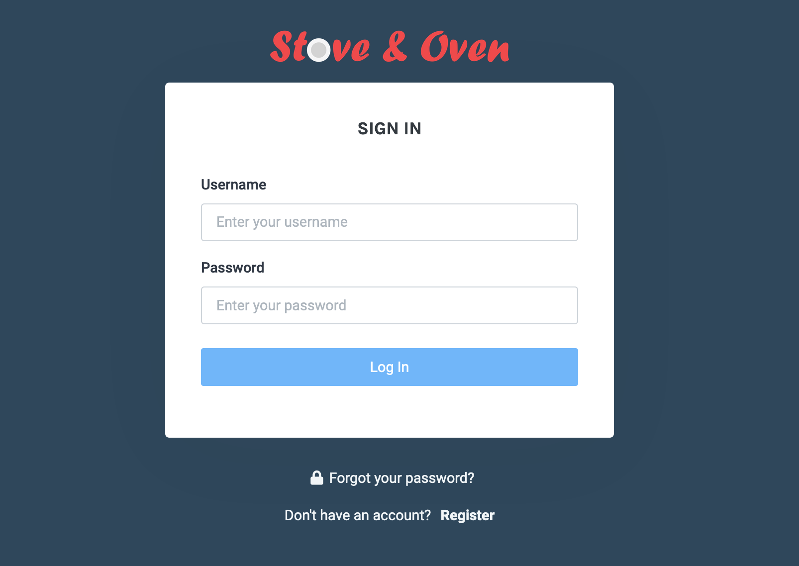
Login
Account Creation using Google
Authentication using Google

Slide 3
Default Dashboard / User’s Refrigerator
GET Inventory of my Profile
If inventory is empty/null, just display “Ingredients: None”
Otherwise, list them out
And the quantities/unit available
GET ALL ingredients available from Ingredients table
Should match Private Postman /api/ingredients output of JSON (i.e. acorn squash, then spice rub, then black pepper..)
On ”Add to Cart”, create “pending list” to be PUT into Inventory (they’ll show up in the right frame as they get added)
Also create a box for quantity
And display unit of measure
On “Remove from Cart”, update “pending list” to (they’ll not show up anymore in the right frame as they get removed)
On “Submit”, PUT “pending list” of Ingredients into Inventory of my Profile

Slide 4
My Recipes
On ”Add to Planner” button push, able to select Mon-Sun to be added in to Planner
PUT Recipe to Profile’s Monday, Tues, Wed, Thurs, Fri, Sat, Sun

Slide 5
Planner – No Recipes added into Plan Yet
GET Recipe and display Recipe Card from Profile’s Monday, Tues, Wed, Thurs, Fri, Sat, Sun, if null / no recipe currently exists display “none selected”

Slide 6
Planner – A recipe added for Monday
GET Recipe and display Recipe Card from Profile’s Monday, Tues, Wed, Thurs, Fri, Sat, Sun, if null / no recipe currently exists display “none selected”

Slide 7
Planner – Create Grocery List
At bottom of Planner page, create Grocery List
On button press “Export Grocery List”,
GET Grocery List (“Profile Inventory” against “Planner Ingredient List”), and display it
Ingredient names
Ingredient quantity and unit of measure

